Slide 1
OncoGuideRx-Leveraging ANN for Targeted Drug Response Prediction

Slide 2
Objectives
Merge data from the GDSC, gene expression, mutation profiles, and CNAs to enhance the accuracy and relevance of drug response predictions.
Build an ANN model to predict IC50 values based on genomic data from multiple datasets.
Develop a Flask-based interface to facilitate easy data input.
Enable users to visualize IC50 predictions along with a comparative graph for five selected drugs.

Slide 3
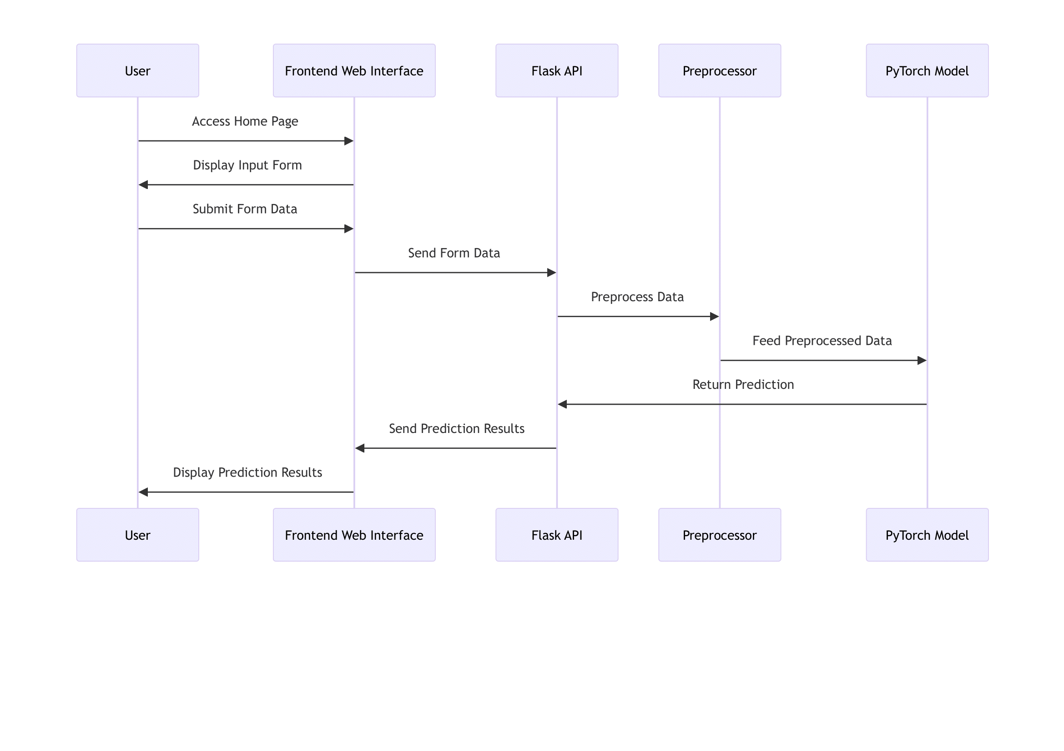
Methodology

Slide 4
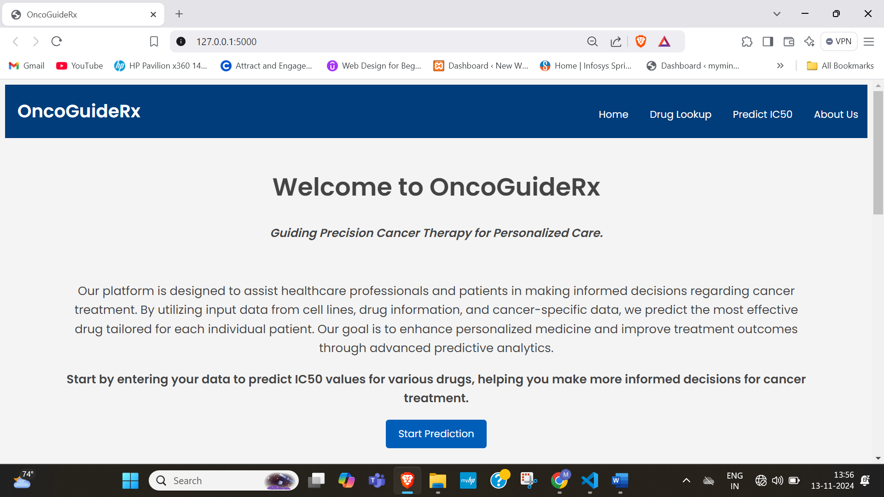
Snapshots
Home Page

Slide 5
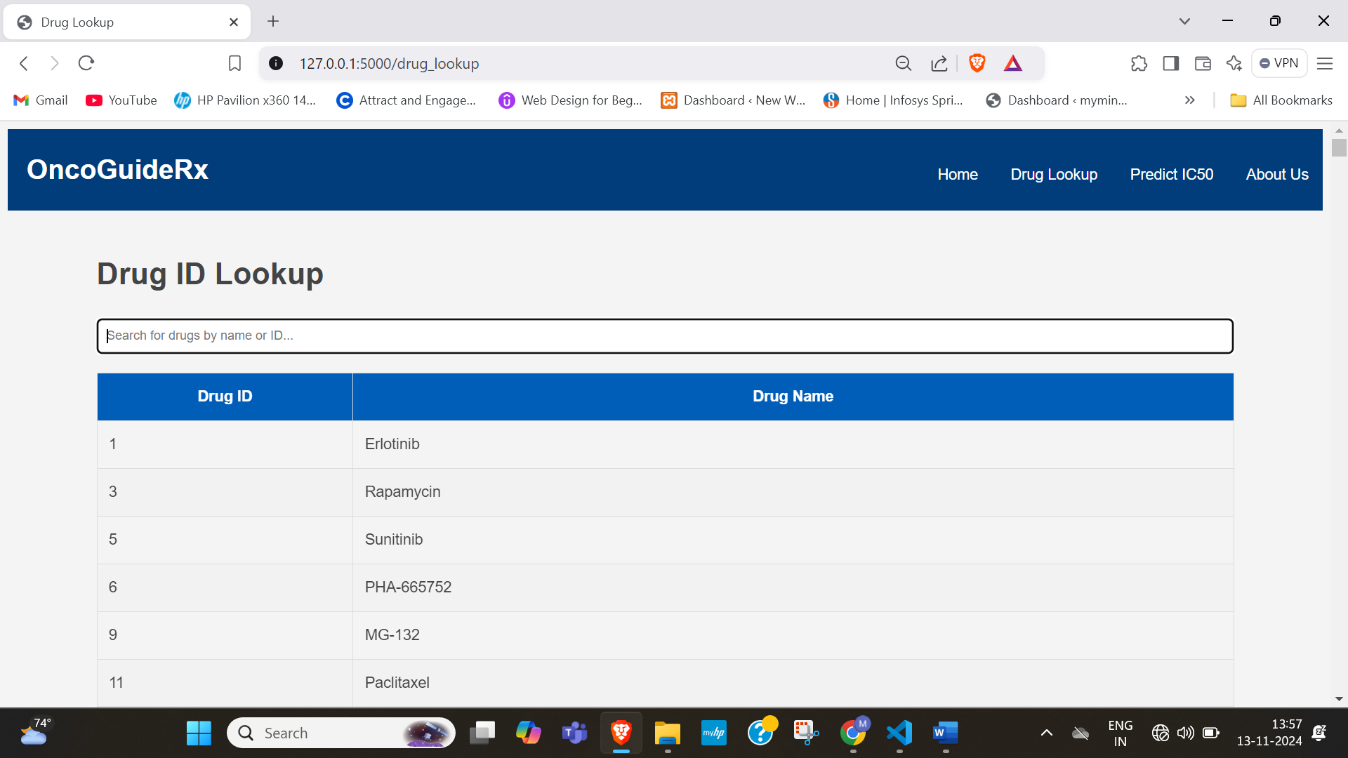
Drug Lookup Page

Slide 6
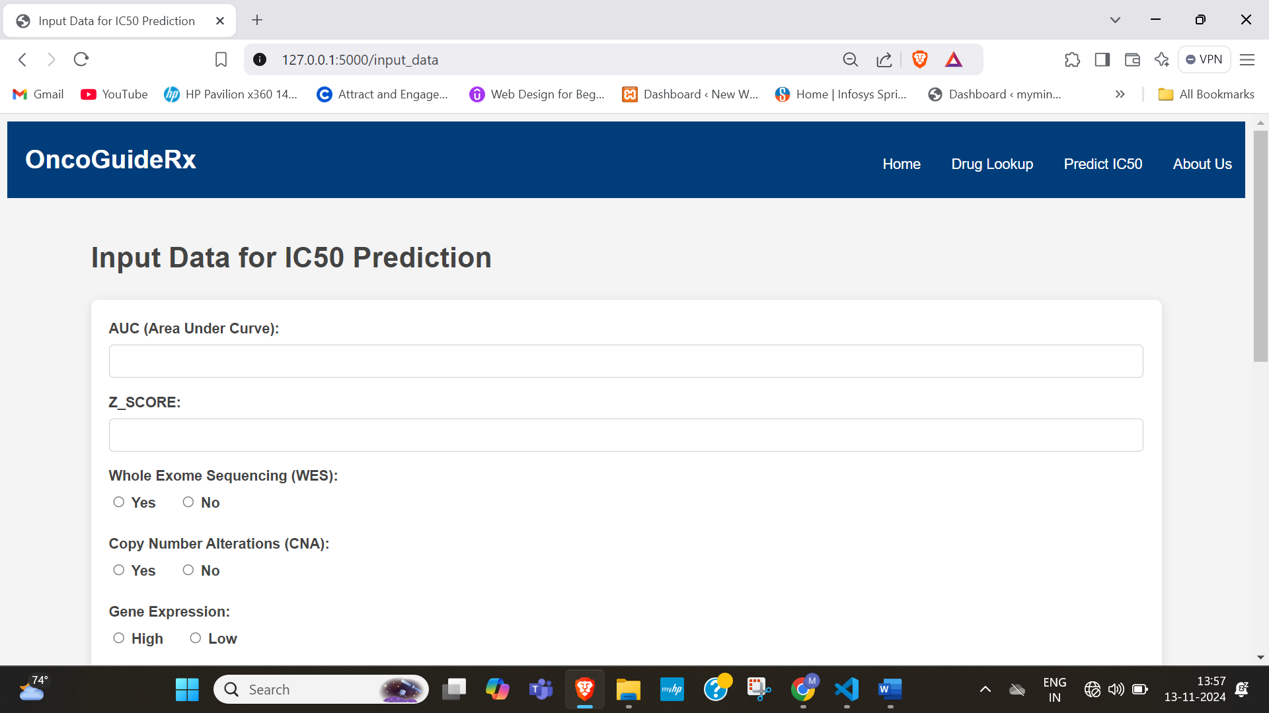
Predicted Page

Slide 7
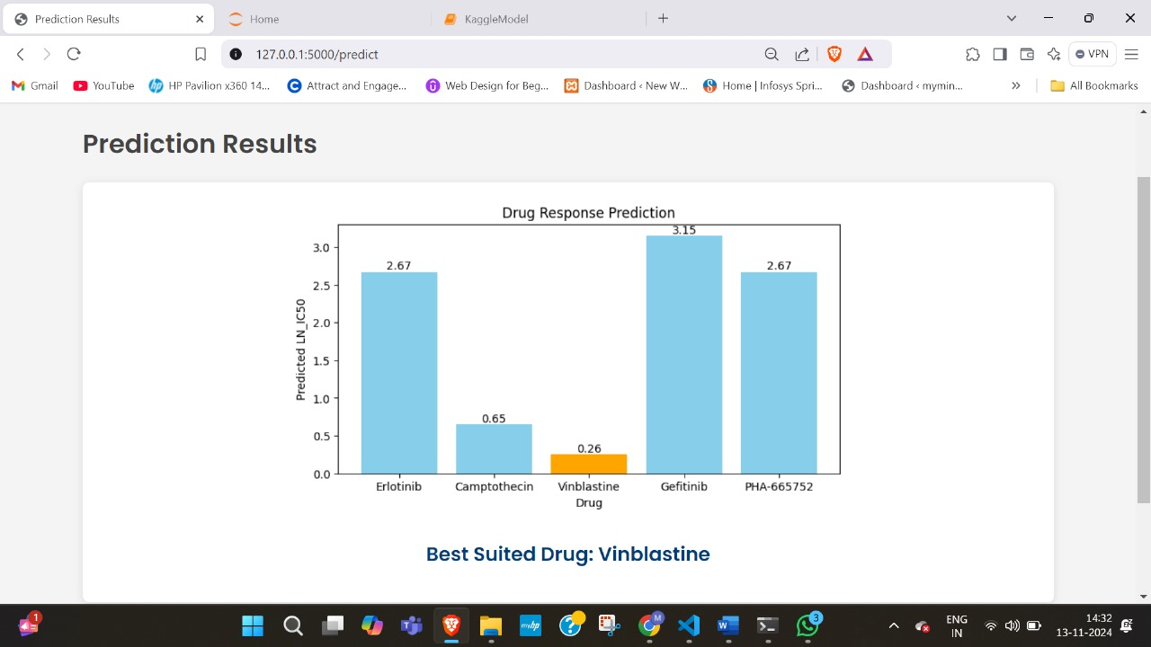
Drug Response Prediction Page

